Slide 1

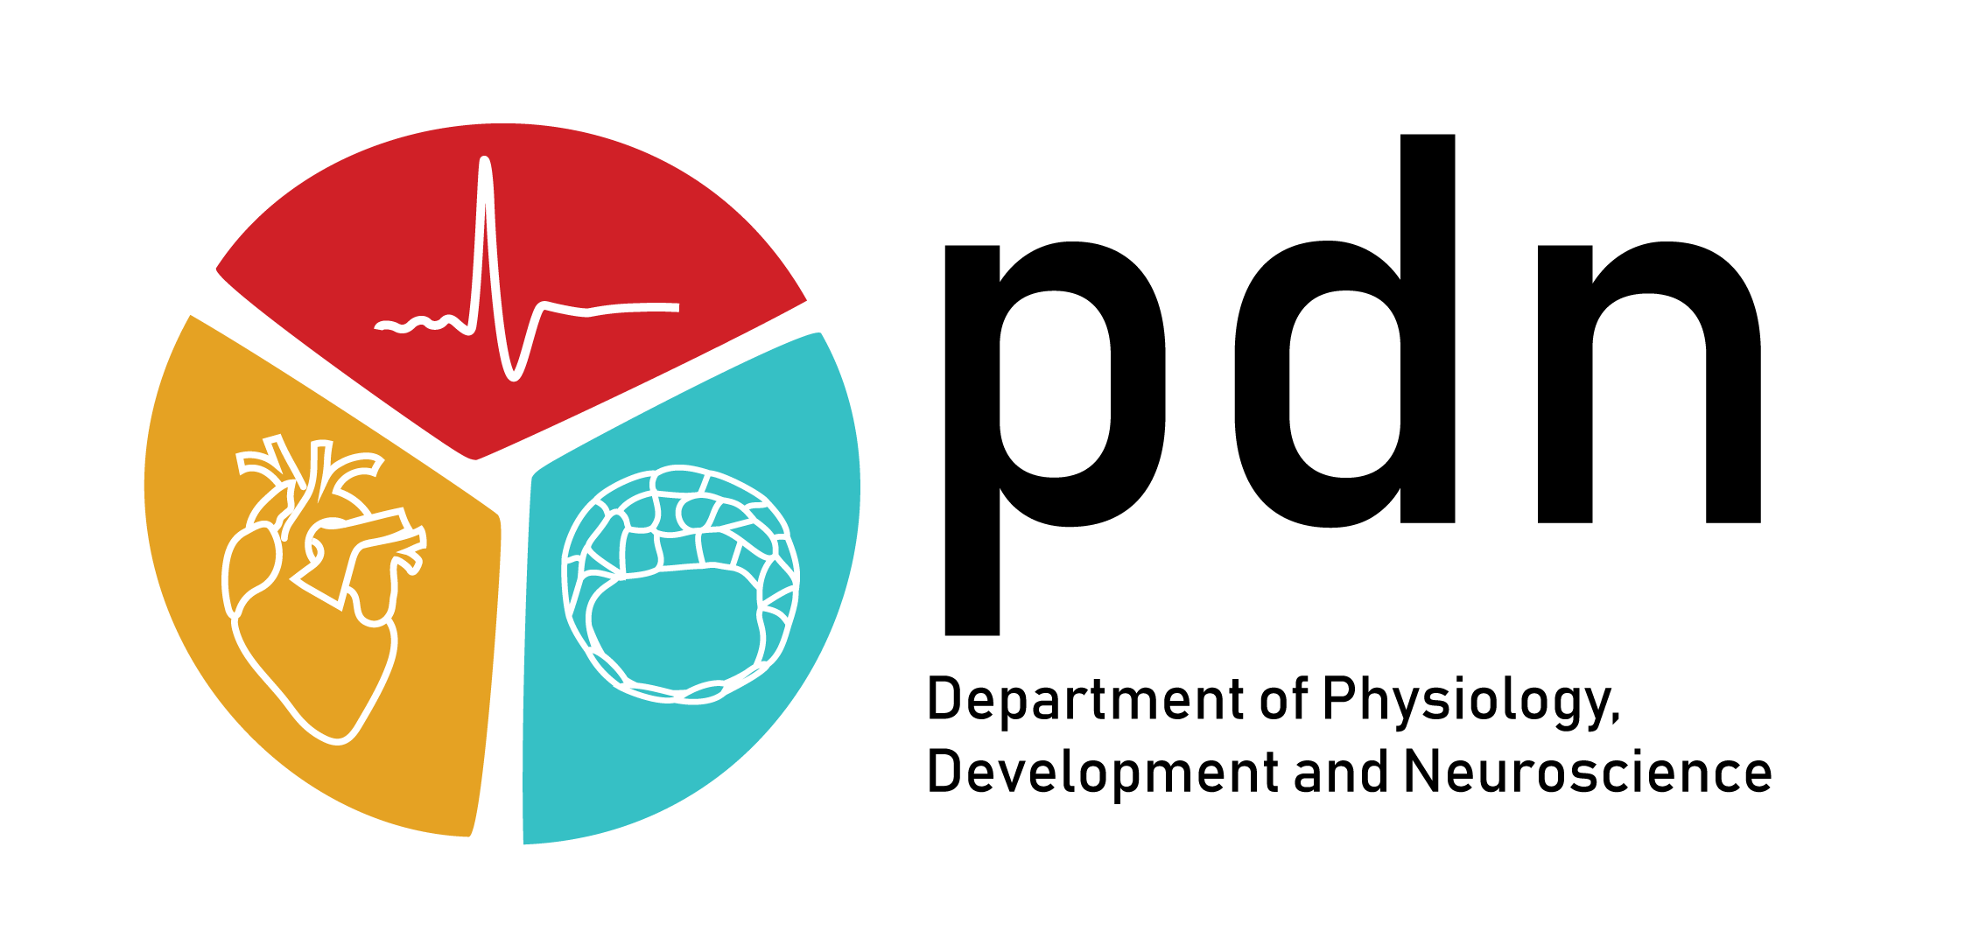

Cortex and blood circulation
PT5050 PHYSIOLOGY
Vincenzo Mastrolia
Research Associate
Department of Physiology, Development and Neuroscience
University of Cambridge

Slide 2
Learning outcomes
Describe the structural and functional organization of the cerebral cortex relevant to sensory and motor processing.
Explain the mechanisms of cortical blood circulation and its regulation under normal and pathological conditions.
Critically analyse the cortical control of movement and its integration with subcortical and spinal systems.
Analyse how cortical regions interact during complex motor tasks
Interpret the impact of cortical dysfunction (e.g., stroke, trauma) on motor performance and rehabilitation outcomes.

Slide 3
The brain cortex
(Dorsal)
(Rostral)
(Caudal)
(Ventral)

Slide 4
The brain cortex

Slide 5
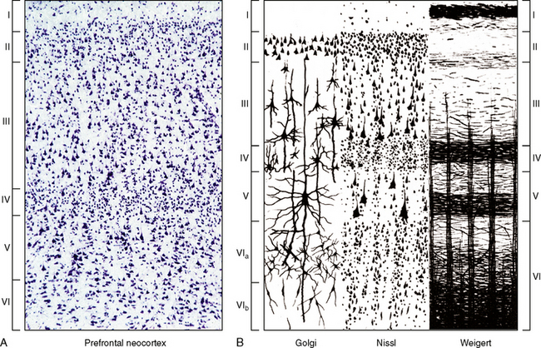
Visualizing the cytoarchitecture of the cortex
Different staining techniques for different features (Golgi, Nissl, Weigert)
Layered structure of the cortex (neocortex)
  I - Molecular layer
  II - Outer granular layer
  III - Outer pyramidal layer
  IV - Inner granular layer
  V - Inner pyramidal layer
  VI - fusiform layer
Formation of neuronal columns
Major cell types in the neocortex
  Pyramidal cells (excitatory)
  Stellate cells (excitatory, if spiny)
  Interneurons (inhibitory, various types also smooth stellate cells)

Slide 6
Visualizing the cytoarchitecture of the cortex
Granular vs agranular areas
  Granular cortex has more stellate cells in layer IV (mostly sensory and associative areas)
  Agranular cortex has fewer stellate cells in layer IV and more pyramidal cells in layer III and V (mostly motor areas)
Different cortical mapping works:
  Brodmann (1909)
  Vogt and Vogt (1919)
  Von Economo and Koskinas (1925)
  Bailey and von Bonin (1951)
  Sarkissov et al. (1955)
Most used mapping is Brodmann’s
Multimodal maps of the cortex

Slide 7
Broadmann Areas
https://www.kenhub.com/en/library/anatomy/brodmann-areas

Slide 8
Primary Somatosensory Area - SI (BA 3-2-1)
Body sensory information (touch, temperature, pain, etc)
Afferents
  Thalamocortical projections (ventroposterior and lateral nuclei)
  Projections areas from ipsilateral motor cortex and from contralateral somatosensory
Efferents
  Ipsilateral motor cortex
  Somatosensory Areas 5 and 40
  Contralateral SI
  Projections to interneurons in thalamus and spinal cord (suppression/inhibition of signals)
Somatotopic organization
Additional somatosensory areas:
  Secondary Somatosensory Area - SII (BA 39-40)
  Somatic Sensory Association Area (BA 5)
  BA 7

Slide 9

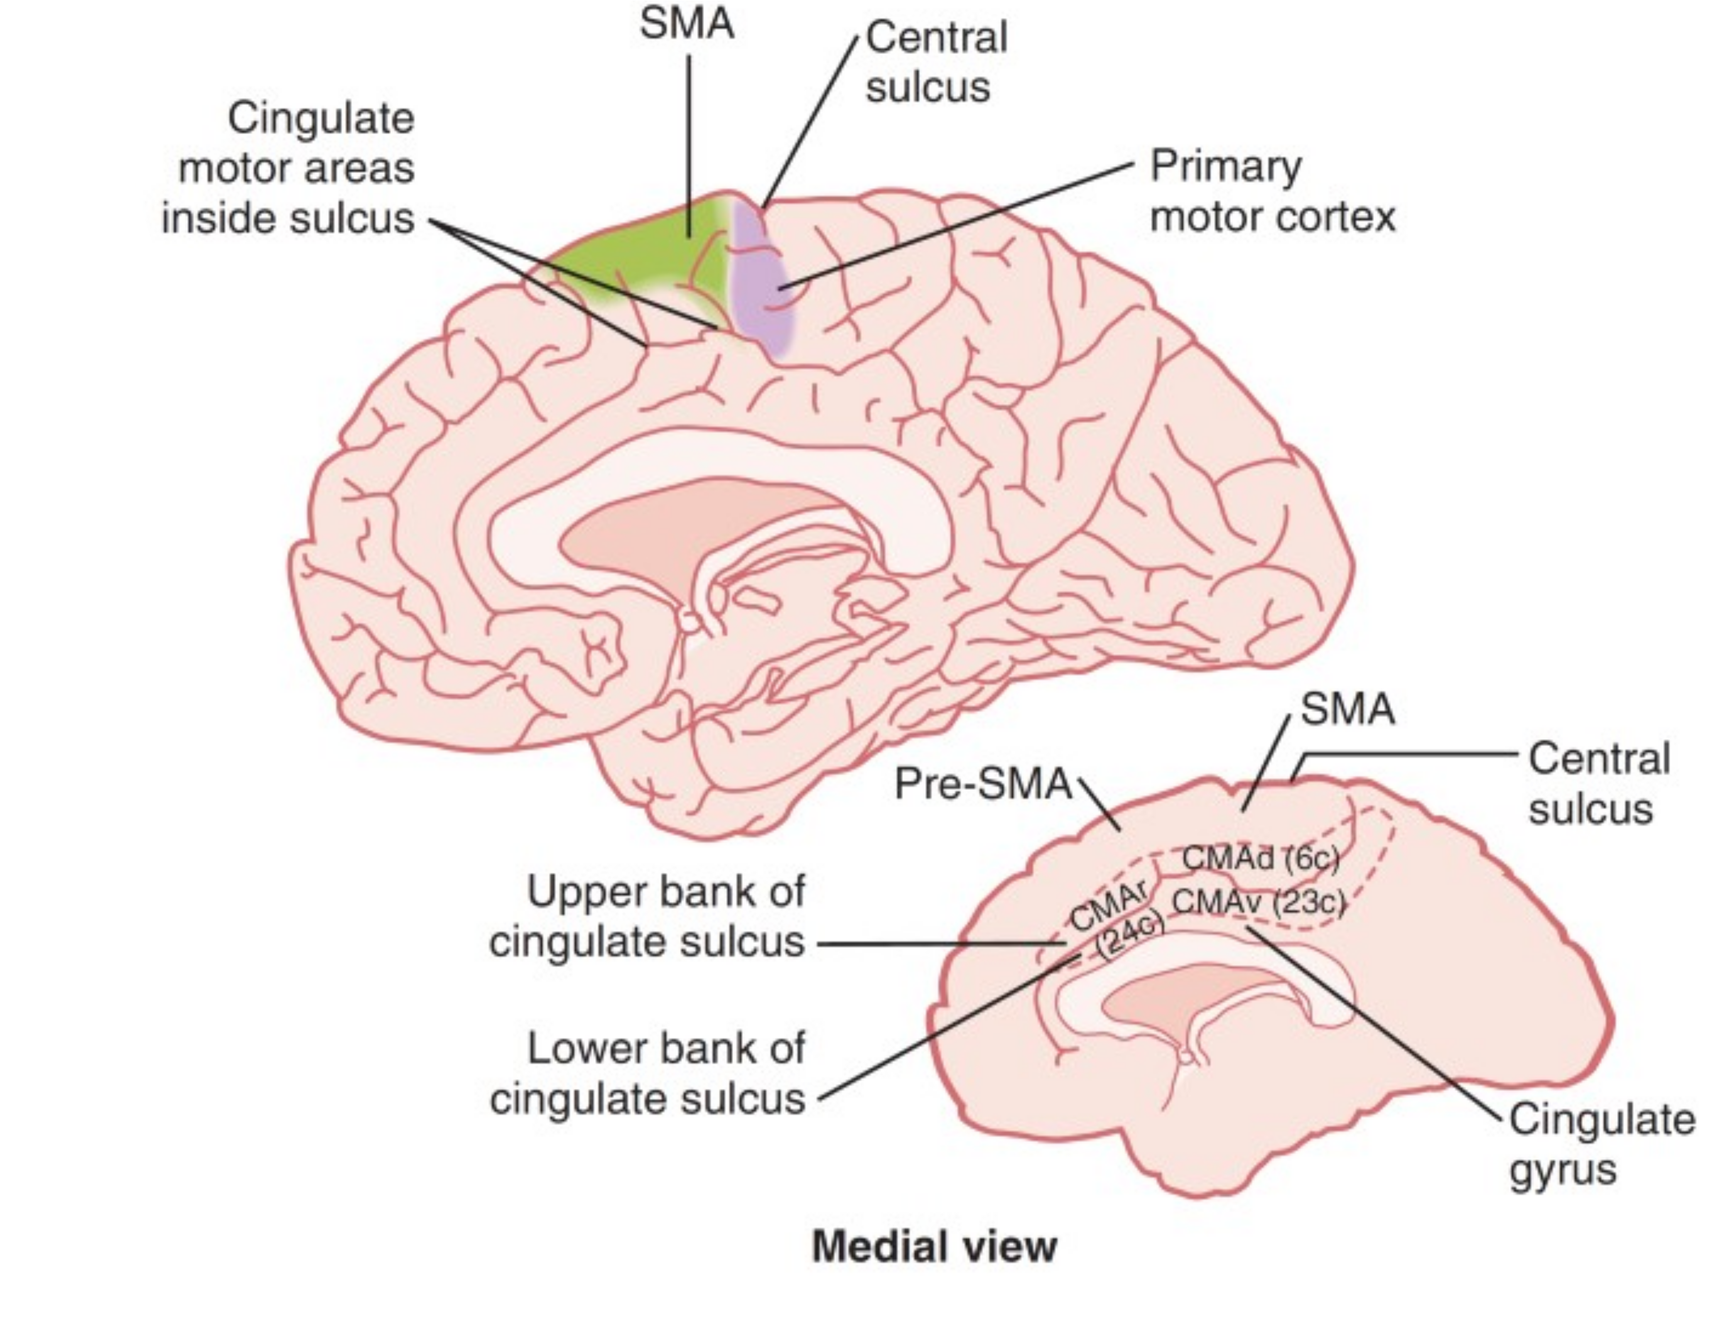
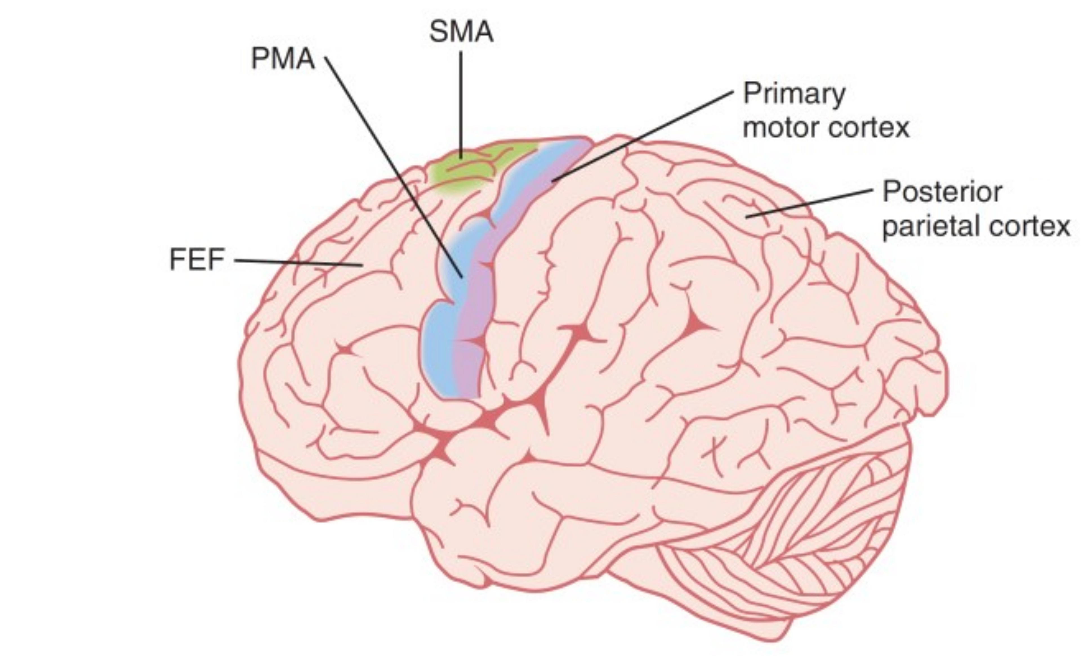
Motor Areas
BA 32-24-23
BA 4 lateral
BA 6 medial
BA 4

Slide 10
Visual cortex (BA 17-18-19)
Primary visual cortex BA 17
  Afferents from the optic radiation (geniculocalcarine tract) coming from lateral geniculate bodies and retinas → Striate cortex
  Alternating neuronal columns between left and right eye (ocular dominance columns)
Association visual cortex BA 18-19 (peristriate or extrastriate cortex)
  Afferents mostly from BA 17 but also from pulvinar
  Important for features extraction (shape, colour, depth, facial recognition, etc.)

Slide 11
Visual cortex (BA 17-18-19)
Primary visual cortex BA 17
  Afferents from the optic radiation (geniculocalcarine tract) coming from lateral geniculate bodies and retinas → Striate cortex
  Alternating neuronal columns between left and right eye (ocular dominance columns)
Association visual cortex BA 18-19 (peristriate or extrastriate cortex)
  Afferents mostly from BA 17 but also from pulvinar
  Important for features extraction (shape, colour, depth, facial recognition, etc.)

Slide 12
Auditory Cortex (BA 41-42-22)
Primary Auditory cortex BA 41-42 (anterior transverse temporal gyrus - Heschl’s gyrus)
  Tonotopic arrangement → posterior side responds to high tones, anterior side to low tones
  Projections from medial geniculate body and contralateral (not only) sound fields
Auditory Association cortex BA 22
  Wernicke’s area
  Speech perception

Slide 13
The prefrontal cortex (PFC - BA 8-12, 44-47, 24 and 32)
Frontal Eye Field (FEF - BA 8)
  Motor control of eye movement
Broca’s Area (BA 44-45)
  Motor control of speech
  Strong inputs from BA 22 (Wernicke’s Area)
  Mirror neuron region
  46-47 for listening own words
Dorsolateral prefrontal cortex (BA 9)
  Supervisory attentional system
  Important for conscious learning
  Memory retrieval
Orbitofrontal cortex (BA 11-14, 47)
  “Cortical representative of the limbic system”
  Association with amygdala, septal area and temporal cortex

Slide 14
The prefrontal cortex (PFC - BA 8-12, 44-47, 24 and 32)
Frontal Eye Field (FEF - BA 8)
  Motor control of eye movement
Broca’s Area (BA 44-45)
  Motor control of speech
  Strong inputs from BA 22 (Wernicke’s Area)
  Mirror neuron region
  46-47 for listening own words
Dorsolateral prefrontal cortex (BA 9)
  Supervisory attentional system
  Important for conscious learning
  Memory retrieval
Orbitofrontal cortex (BA 11-14, 47)
  “Cortical representative of the limbic system”
  Association with amygdala, septal area and temporal cortex

Slide 15
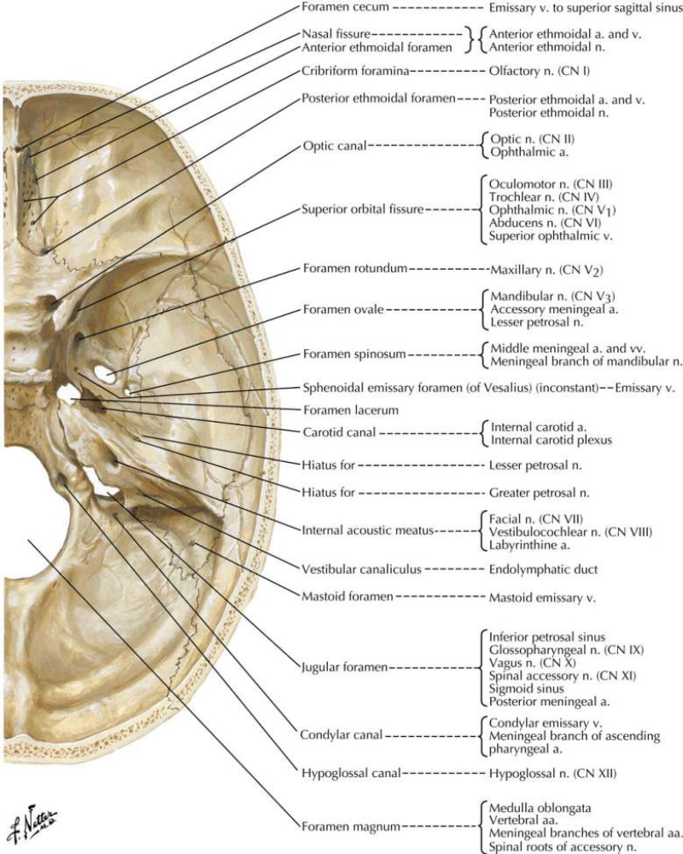
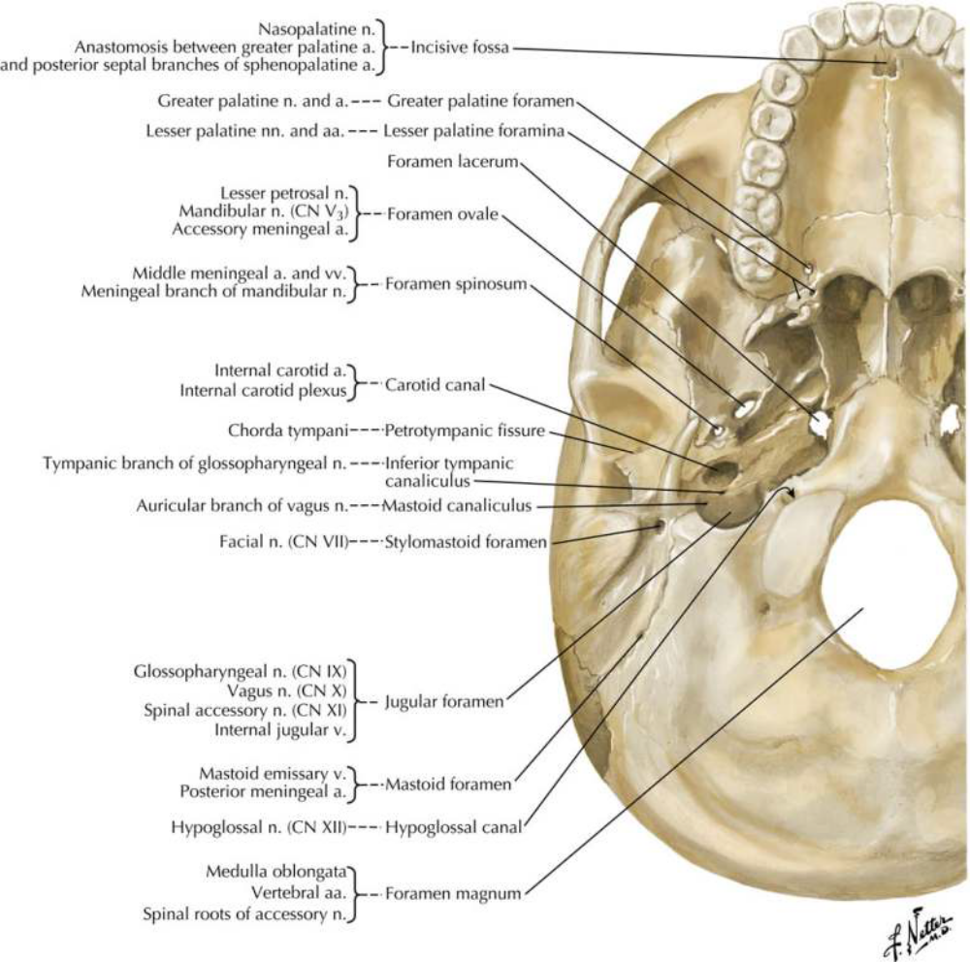
The cranial floor

Slide 16
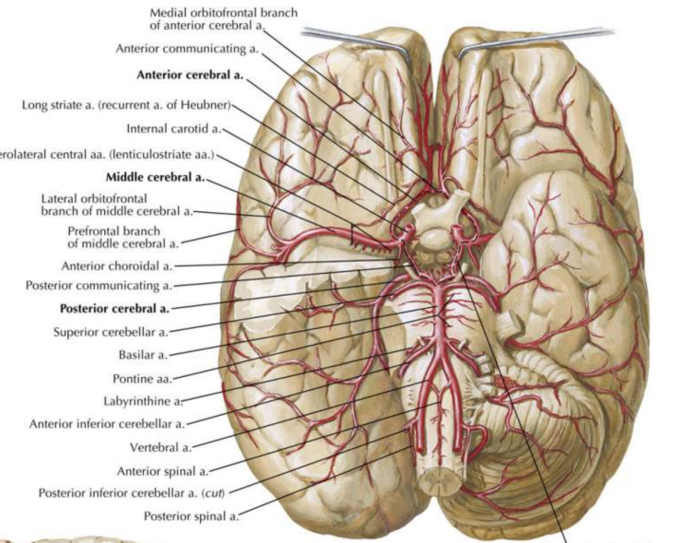
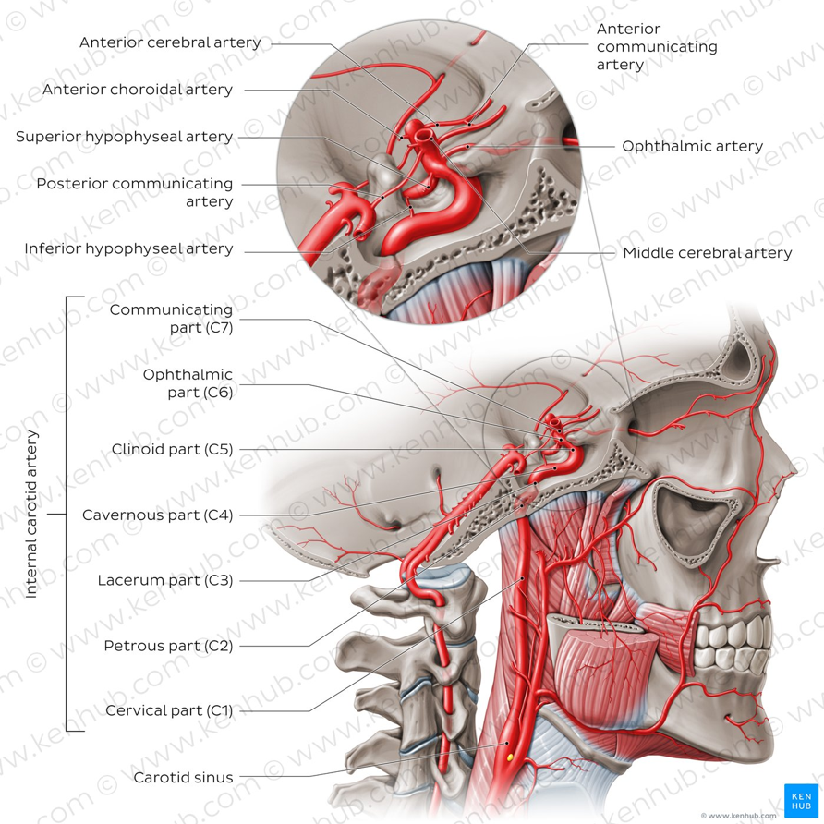
Brain vasculature
2 main source arteries
  Internal carotid arteries
  Vertebral arteries → Basilar artery

Slide 17
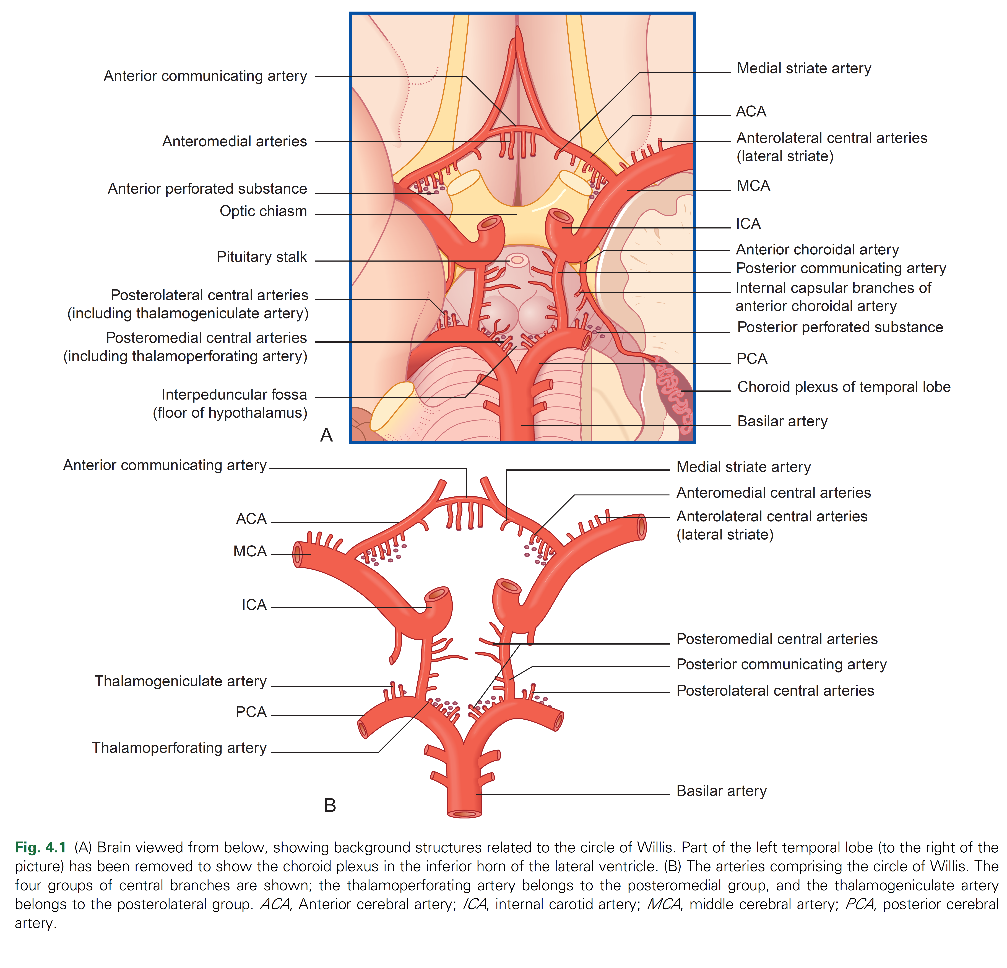
Brain vasculature
2 main source arteries
  Internal carotid arteries
  Vertebral arteries → Basilar artery
Circle of Willis
  Anastomotic arterial connection
3 main cerebral arteries
  Anterior cerebral artery
  Middle cerebral artery
  Posterior cerebral artery

Slide 18
Brain vasculature
2 main source arteries
  Internal carotid arteries
  Vertebral arteries → Basilar artery
Circle of Willis
  Anastomotic arterial connection
3 main cerebral arteries
  Anterior cerebral artery
  Middle cerebral artery
  Posterior cerebral artery

Slide 19
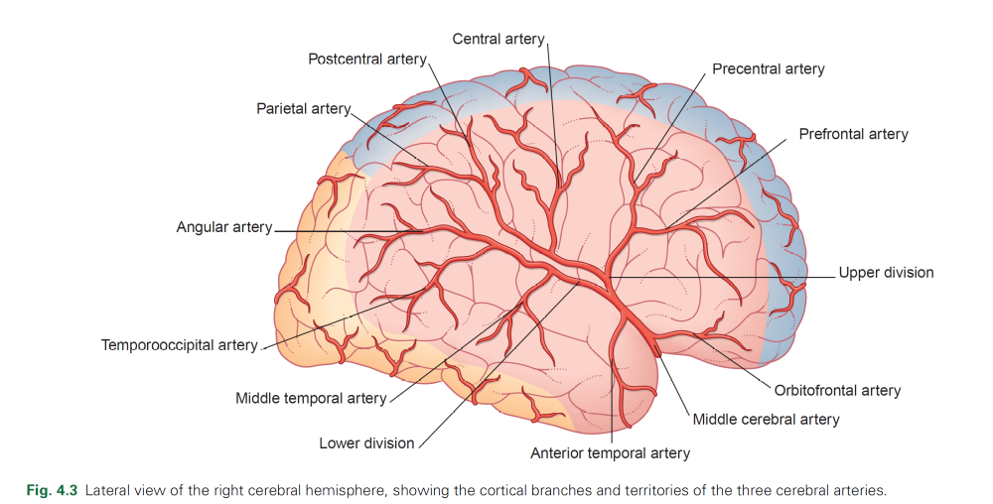
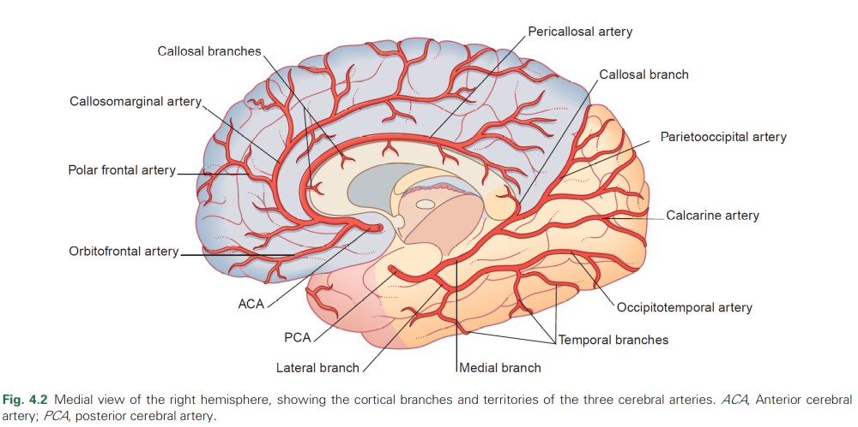
Cortex vasculature

Slide 20
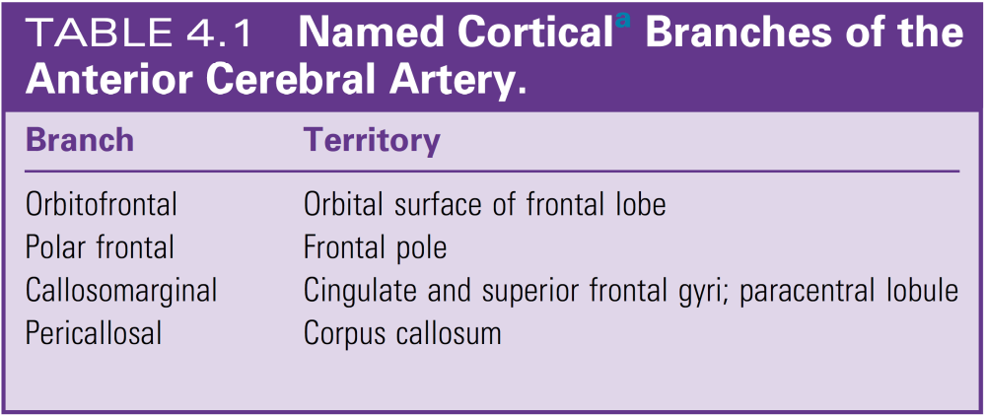
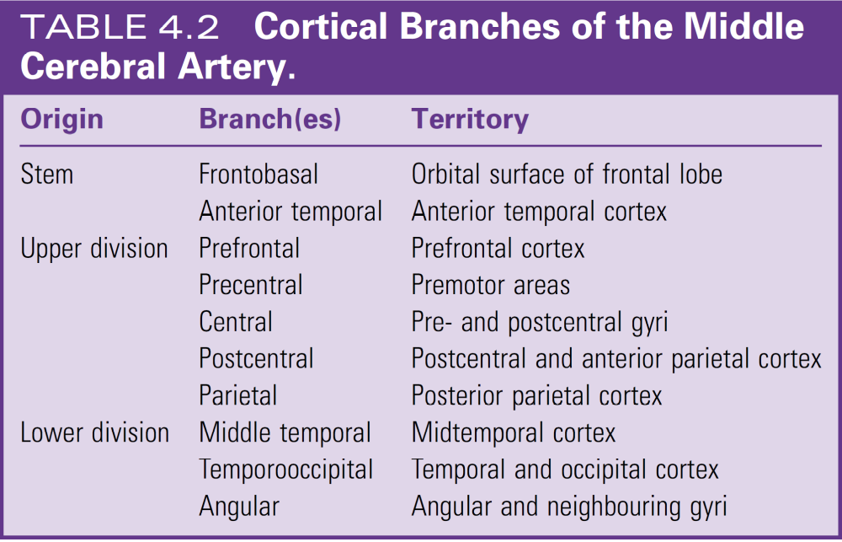
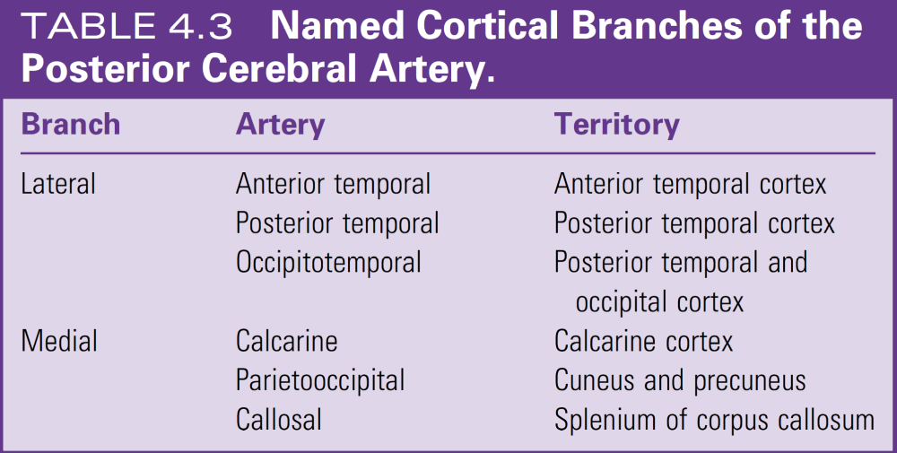
Cortex vasculature

Slide 21
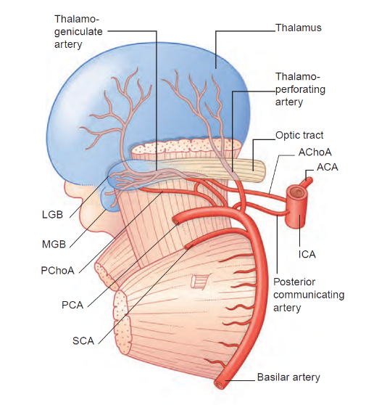
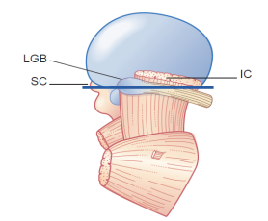
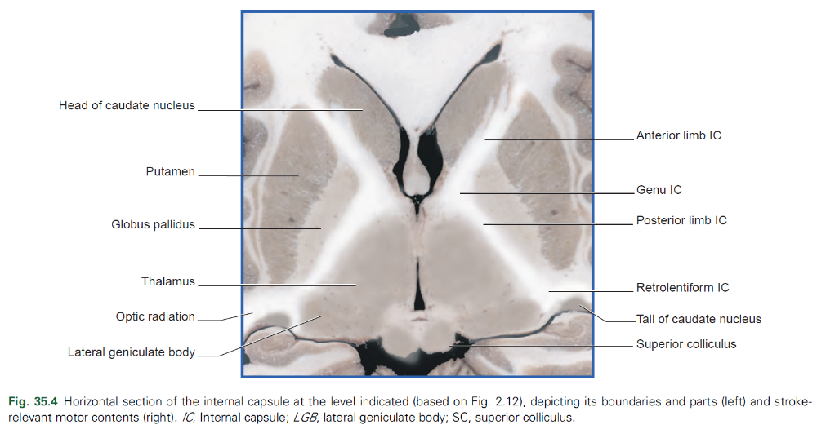
Internal brain vasculature
Anterior cerebral artery
  Anterior choroidal artery → Internal capsule
  Medial Striate artery → Internal capsule and head of caudate nucleus
Medial cerebral artery
  Lateral Striate arteries → Striatum, internal capsule, thalamus
Posterior cerebral artery
  Midbrain
  Posterior choroidal artery → Ventricle
  Central arteries → Thalamus, subthalamic nucleus and optic radiation
Vertebral and basal arteries
  Anterior and posterior spinal arteries → Medulla
  Posterior inferior cerebellar artery → Medulla and cerebellum
  Anterior inferior and superior cerebellar artery → Pons and cerebellum

Slide 22
Internal brain vasculature
Anterior cerebral artery
  Anterior choroidal artery → Internal capsule
  Medial Striate artery → Internal capsule and head of caudate nucleus
Medial cerebral artery
  Lateral Striate arteries → Striatum, internal capsule, thalamus
Posterior cerebral artery
  Midbrain
  Posterior choroidal artery → Ventricle
  Central arteries → Thalamus, subthalamic nucleus and optic radiation
Vertebral and basal arteries
  Anterior and posterior spinal arteries → Medulla
  Posterior inferior cerebellar artery → Medulla and cerebellum
  Anterior inferior and superior cerebellar artery → Pons and cerebellum

Slide 23
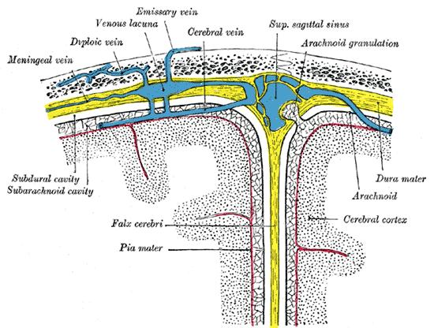
Brain vasculature: veins

Slide 24
Cortical control of movement and descending tracts

Slide 25
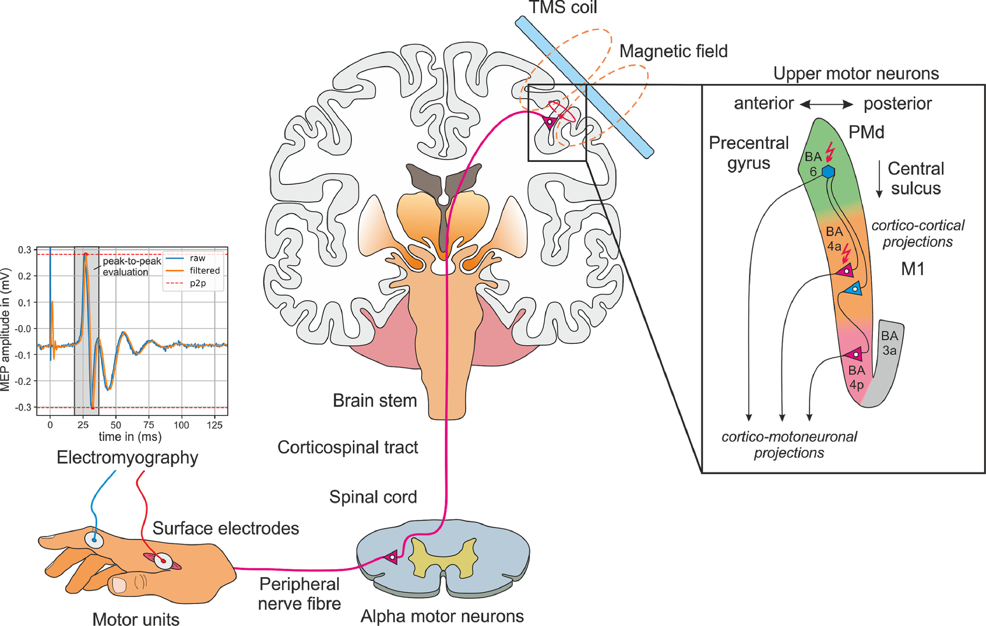
Mapping the motor areas
TMS = Trans-magnetic stimulation
Motor areas are defined as those from which movement can be evoked by the lowest stimulus intensity
https://doi.org/10.1016/j.neuroimage.2021.118654
Notes:
On the basis of
these stimulation studies, the effects produced by lesions,
results of anatomical experiments, electrophysiological recordings,
and modern imaging studies in humans, many
“motor” areas of the cerebral cortex have been recognized

Slide 26
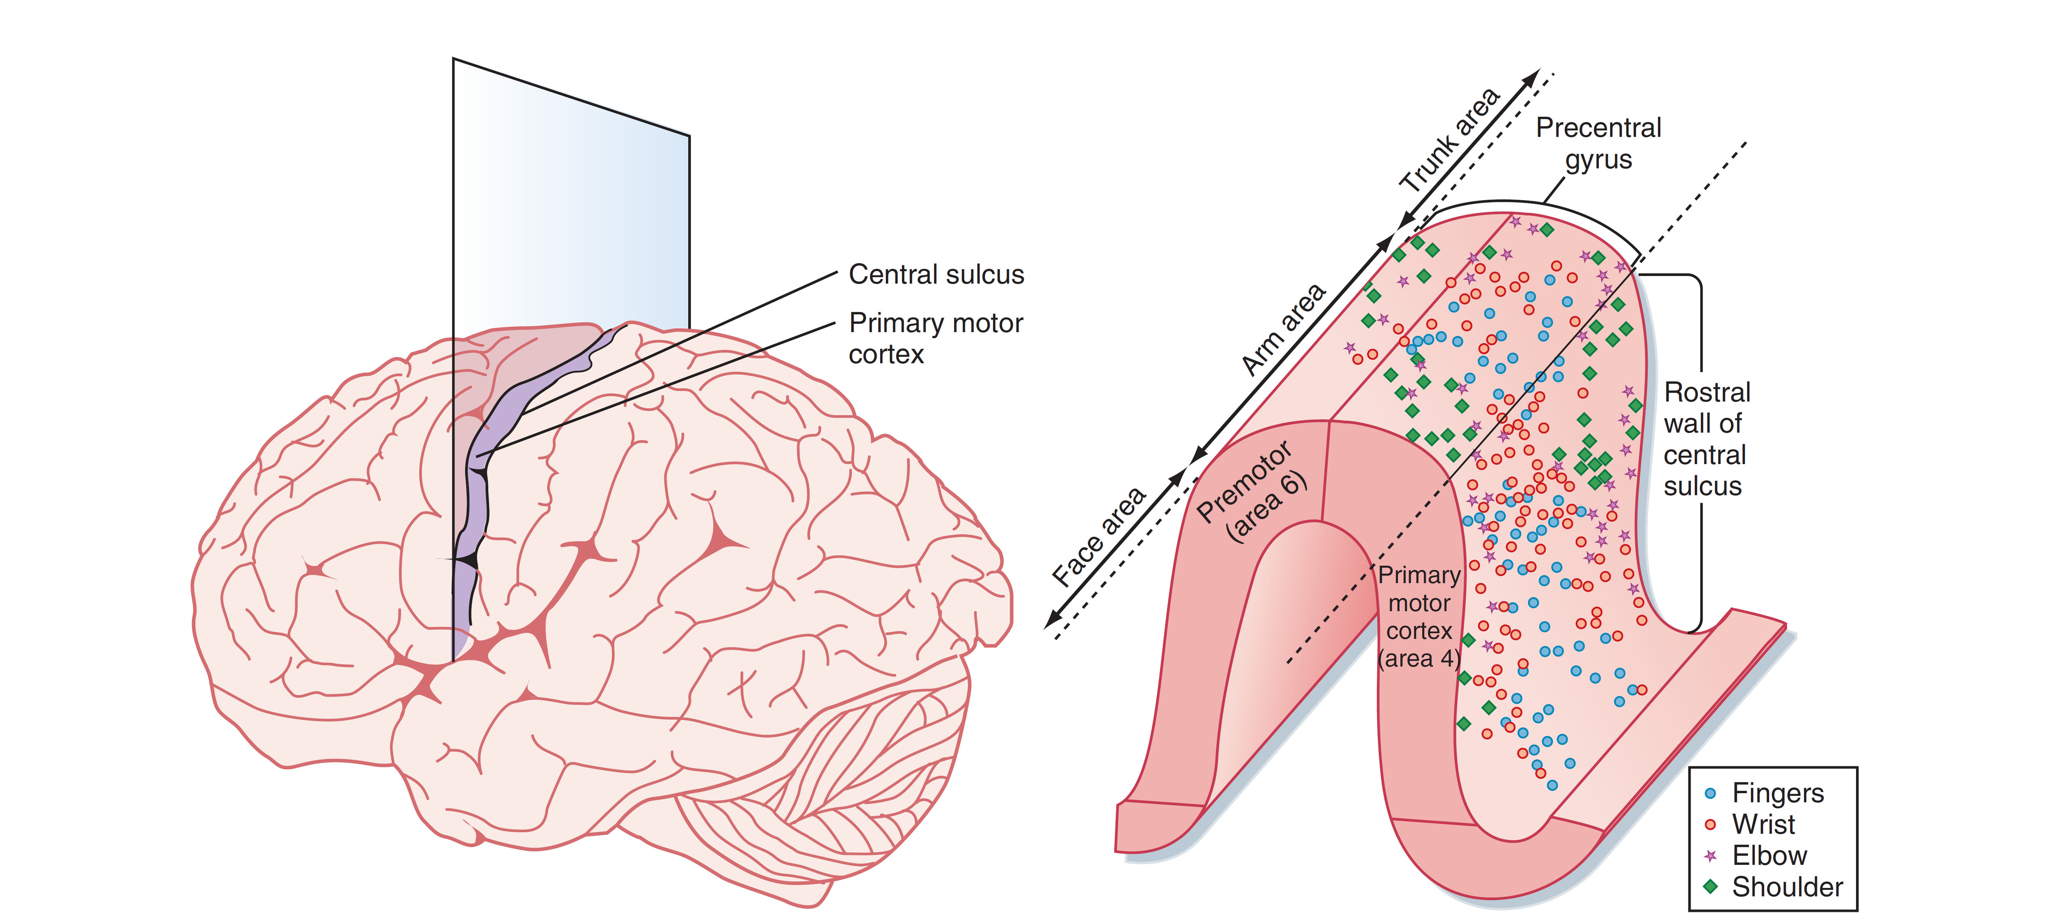
Primary motor cortex (BA4)

Slide 27
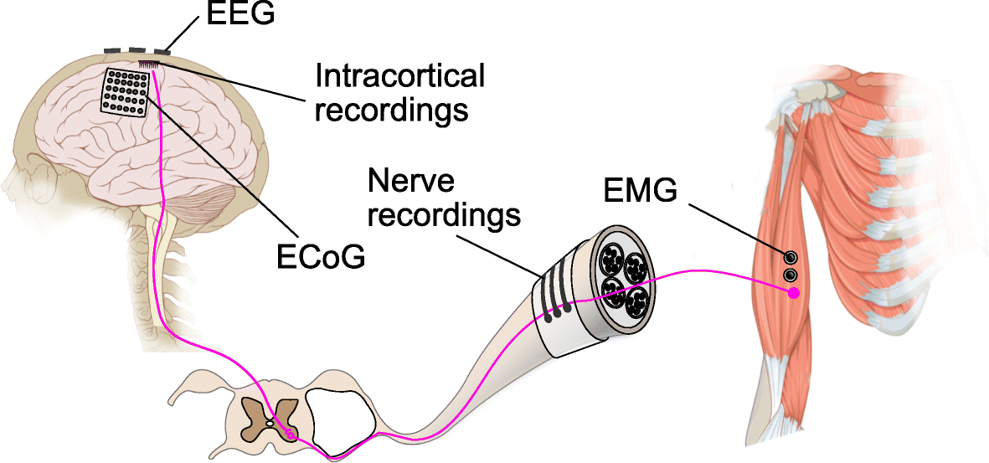
PMA refined structure
Intracortical microstimulation
https://doi.org/10.1186/s42490-019-0022-z

Slide 28
Supplementary Motor Area (BA6 medial)
Divided into SMA-proper and pre-SMA
SMA-proper:
  Somatotopic organization
  Projects to corticospinal tract and other motor areas
Pre-SMA connected to prefrontal cortex

Slide 29
Premotor Area (BA6 lateral)
Somatotopic organization
Divided in dorsal and ventral
  Ventral for upper limb and head movement
  Dorsal coordinates more proximal muscles while ventral coordinates more distal muscles

Slide 30
Cingulate Motor Areas
Somatotopic organization
Rostral, dorsal and ventral cingulate areas
Contribute to corticospinal tract
Related to preparation and execution of movement

Slide 31
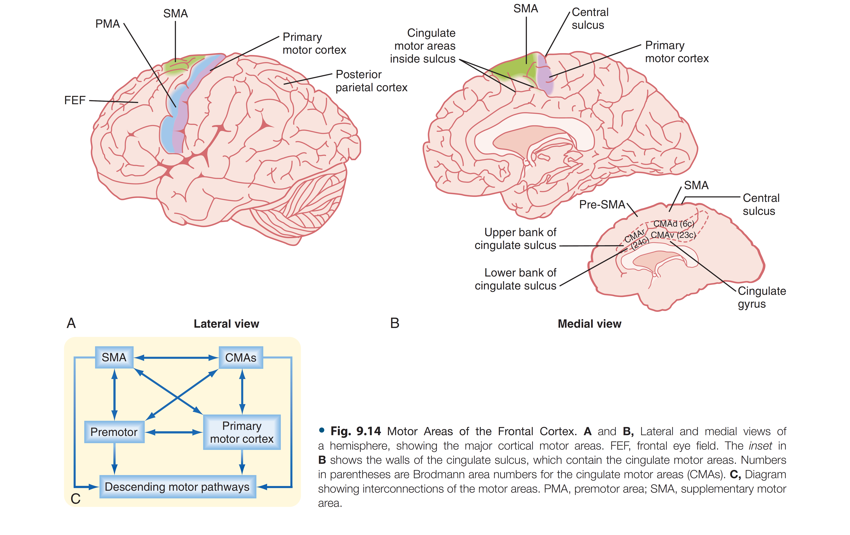
Interconnected motor areas

Slide 32
Descending tracts

Slide 33
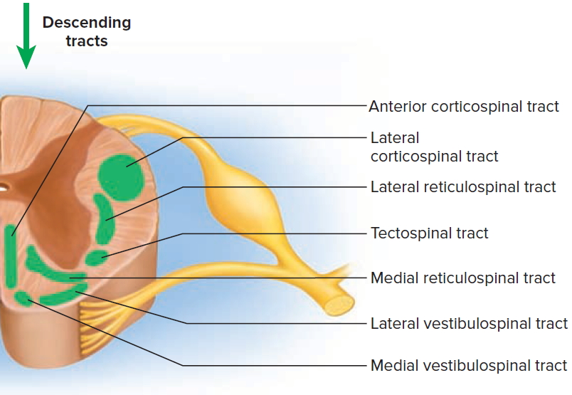
Descending tracts

Slide 34
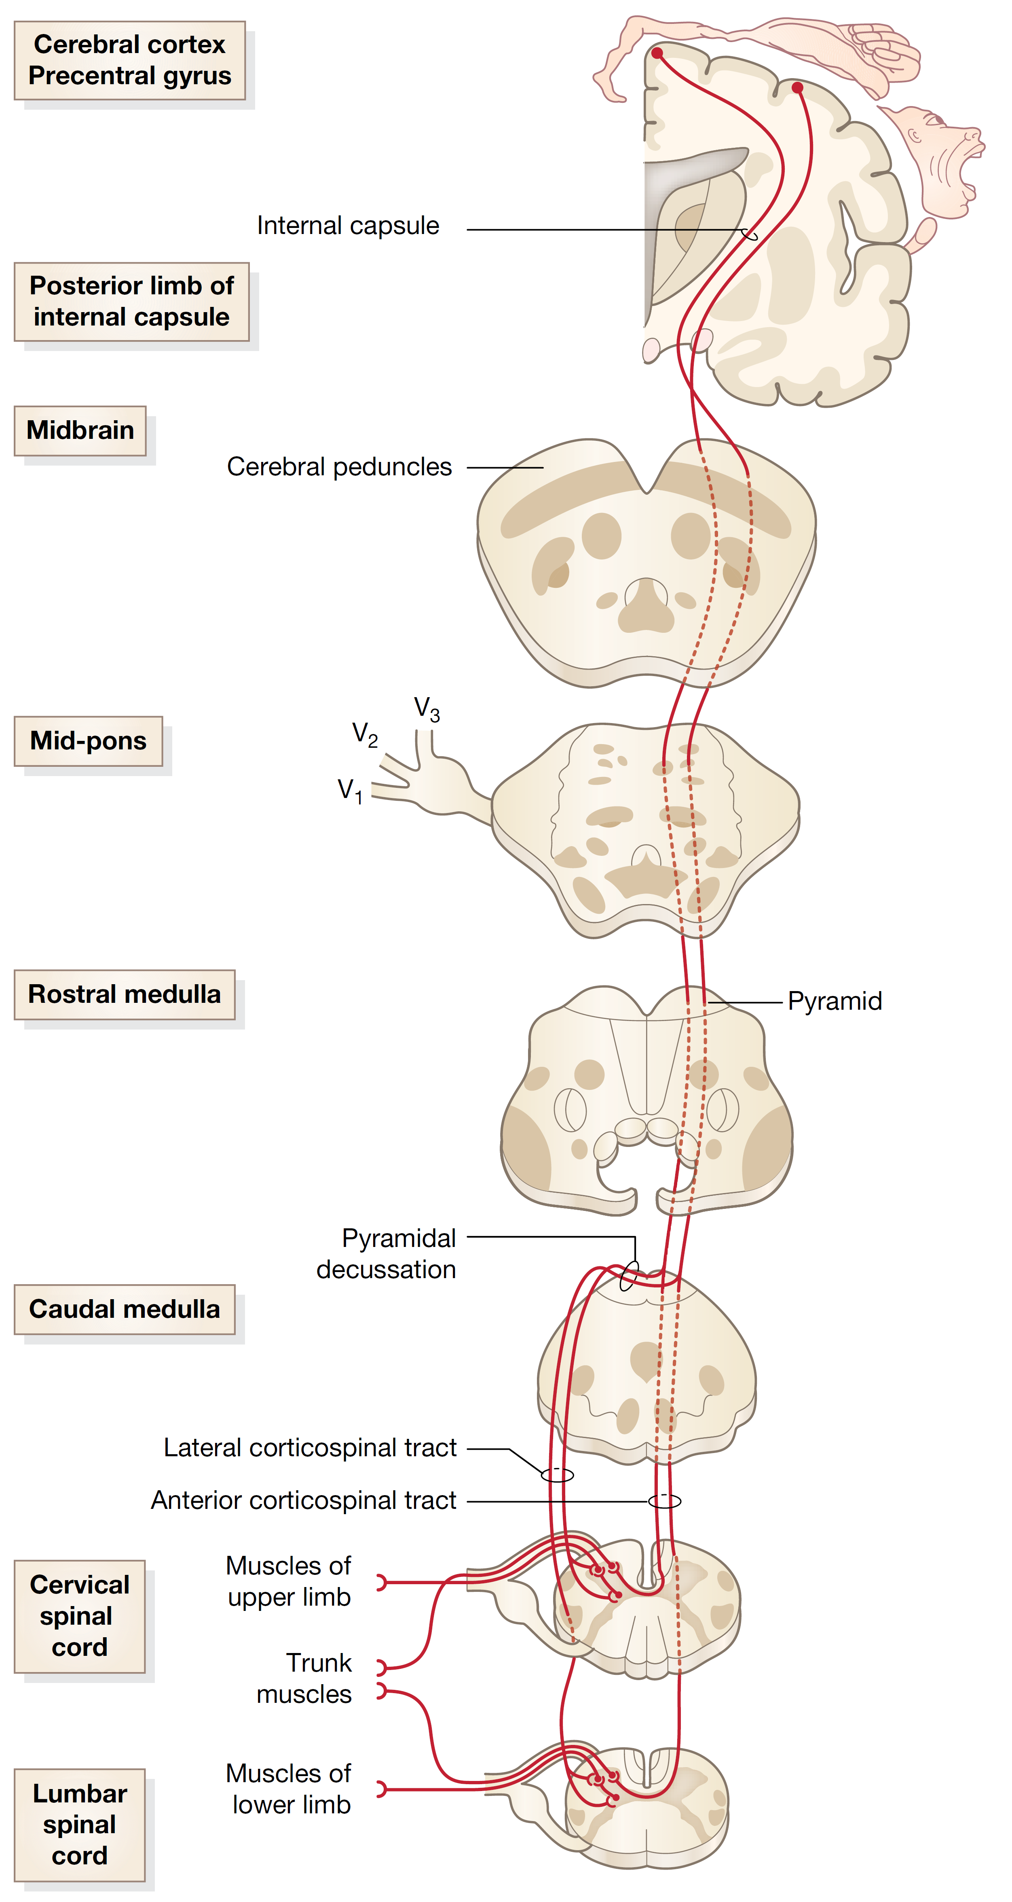
Corticospinal tract
Primary Motor cortex neurons
Supplementary motor cortex neurons
Cerebral
cortex
Upper
motorneurons
Internal
Capsule
Cerebral
Peduncles
Midbrain
Pyramids
Medulla
Lateral
Corticospinal Tract
Anterior
Corticospinal Tract
Lower
motorneurons
Anterior horn of the spinal cord neurons
Spinal Cord
Muscles
Trunk Muscles
Movement

Slide 35
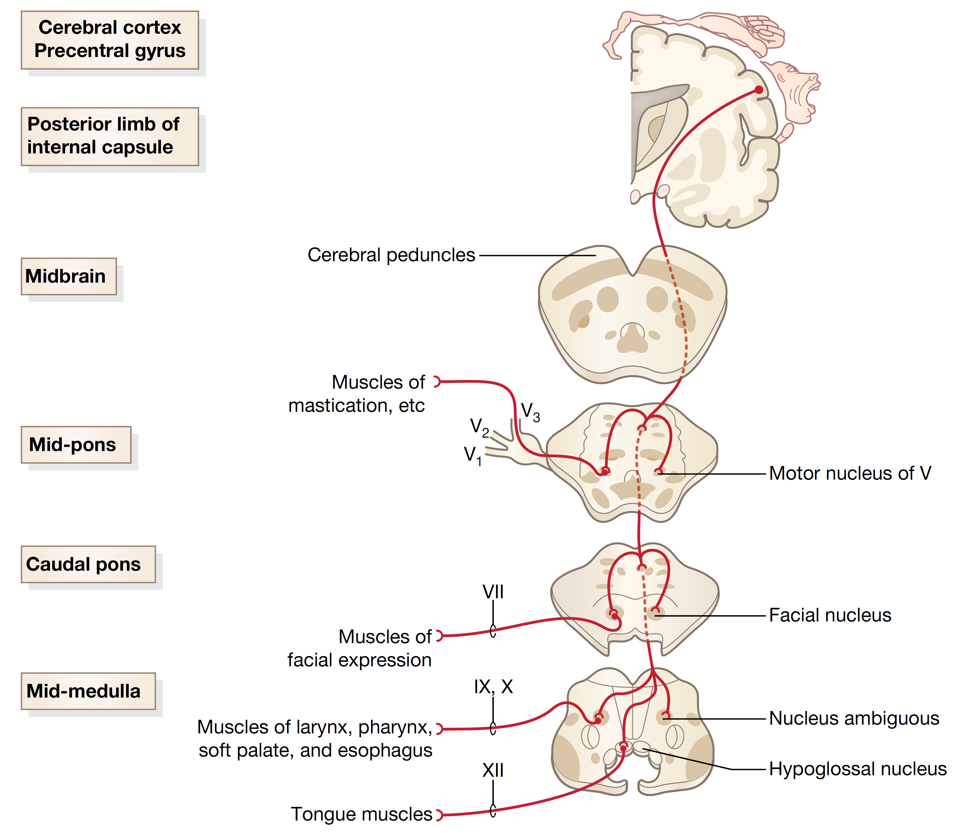
Corticobulbar tract: motorneurons of the cranial nerves
Primary Motor cortex neurons
Supplementary motor cortex neurons
Cerebral
cortex
Upper
motorneurons
Internal
Capsule
Cerebral
Peduncles
Midbrain
Motor Nucleus of the Trigeminal (V)
Jaw muscles
Forehead
Pons
Facial Nucleus (VII)
Facial expression muscles
Lower
motorneurons
Nucleus Ambiguous (IX,X)
Larynx, pharynx, soft palate, esophagous muscles
Medulla
Hypoglossal Nucleus (XII)
Tongue muscles
Movement

Slide 36
Descending tracts

Slide 37
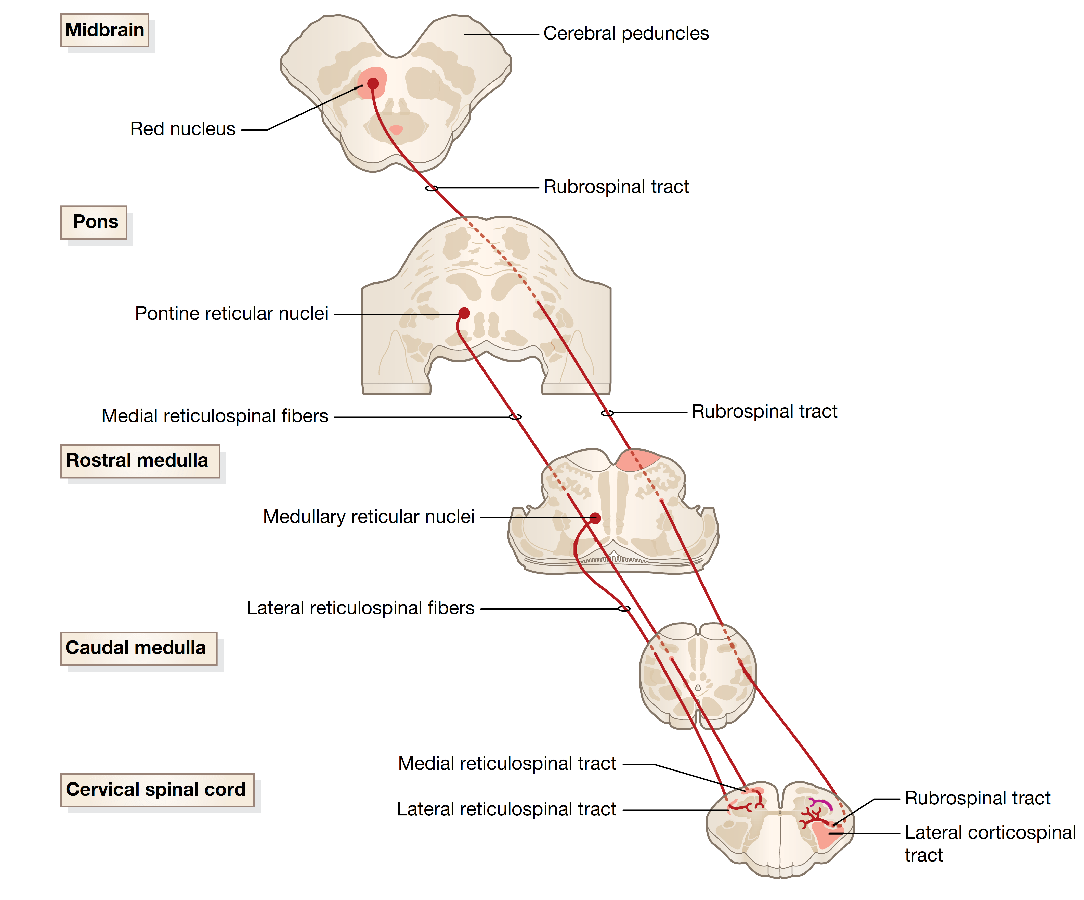
Rubrospinal and reticulospinal
First order
neurons
Red Nucleus
neurons
Midbrain
Rubrospinal
tract
Pons
Reticular Formation
neurons
Medulla
Medial Reticulospinal Fibers
Lateral Reticulospinal Fibers
Second order
neurons
Spinal Cord
Spinal cord grey matter neurons
Modifying tone in upper extremities flexors?
Pain Modulation information + coodination
Modulation of Movement/Coordination

Slide 38
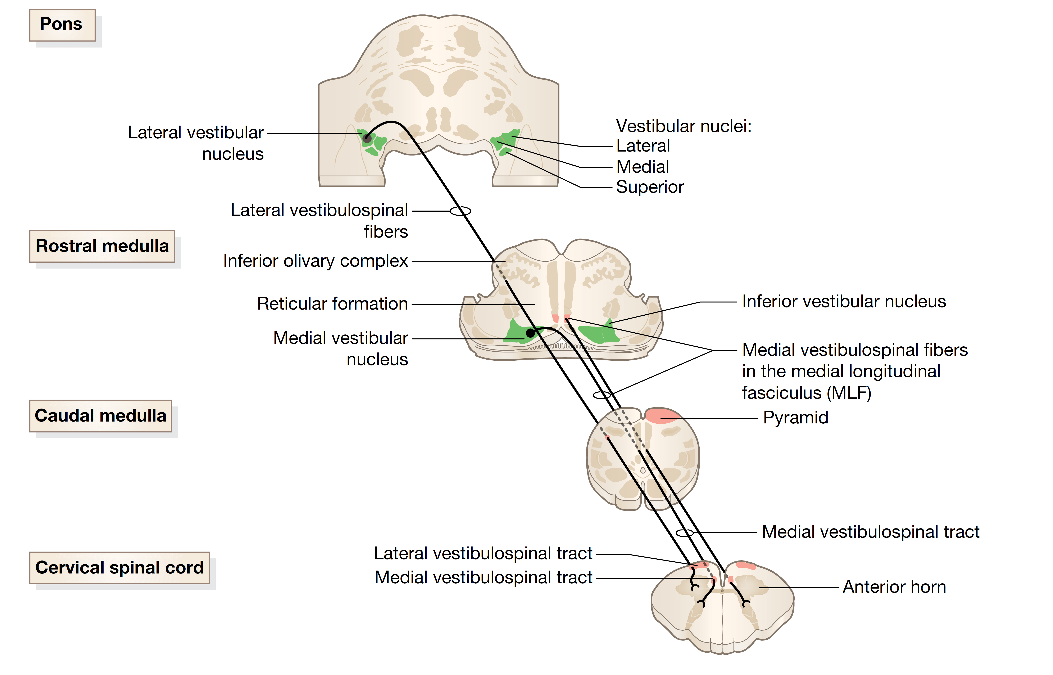
Vestibulospinal tracts
Lateral
Vestibular
Nucleus
neurons
First order
neurons
Pons
Medial
Vestibular
Nucleus
neurons
Medulla
Lateral Vestibulospinal
tract
Medial Vestibulospinal
tract
Second order
neurons
Spinal Cord
Spinal cord grey matter neurons (till mid-thoracic)
Spinal cord grey matter neurons
Coordinate balance and posture

Slide 39
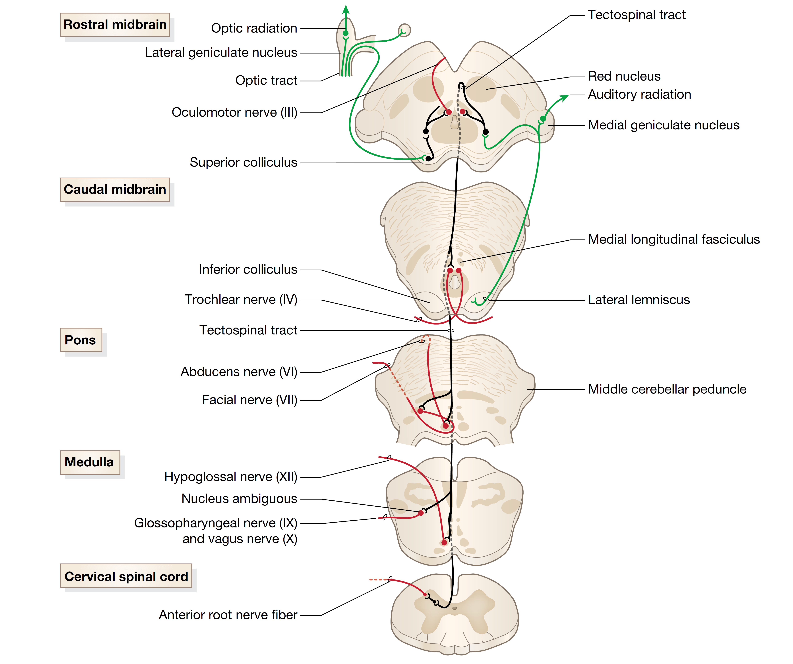
Tectospinal tracts
Visual and Auditory stimuli
Midbrain
First order
neurons
Superior
Colliculus
neurons
Pons
Medial Longitudinal Fasciculus
Medulla
Second order
neurons
Spinal cord grey matter neurons
Cervical
Spinal Cord
Head movement in response to visual and auditory stimuli

Slide 40
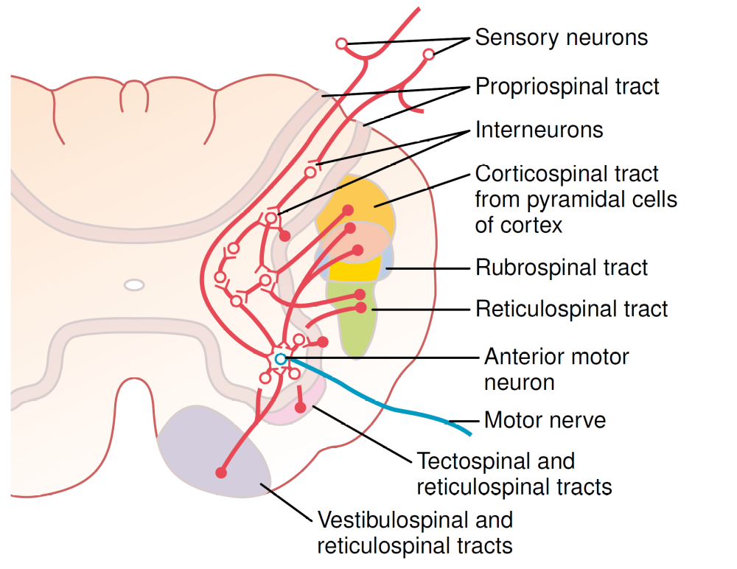
Descending tracts modulation in the spinal cord

Slide 41
Lesions of cortical motor areas

Slide 42
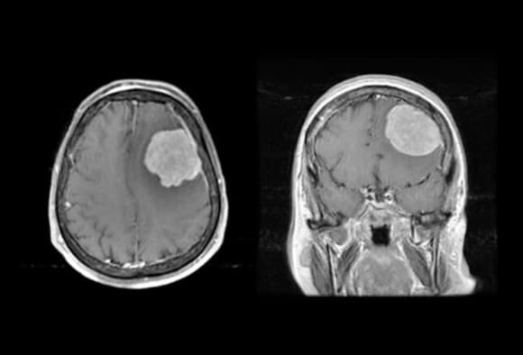
Lesions of cortical motor areas: Upper motor neuron syndrome
“UMN lesions are designated as any damage to the motor neurons that reside above nuclei of cranial nerves or the anterior horn cells of the spinal cord”
Causes:
  Stroke
  Brain injury (trauma or other causes, e.g.
  hypoxia, infections)
  Motorneuron diseases (MND)
  Infections
  Malignancy
  Neuro-immunological disorders
  Degenerative disorders

Slide 43
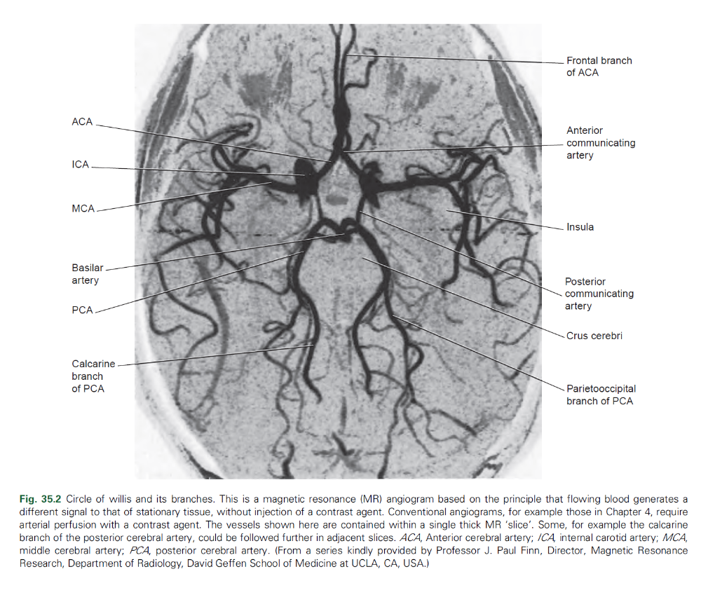
Stroke
Interruption of the blood flow to the brain or retina
Ischemic (85%)
  Atherosclerosis (fatty deposits in internal carotid or vertebral arteries)
  Atherothrombosis
  Lacunar
Haemorrhagic (15%)
  Intracerebral (10%) vs subarachnoid (5%)
  Aneurysm

Slide 44
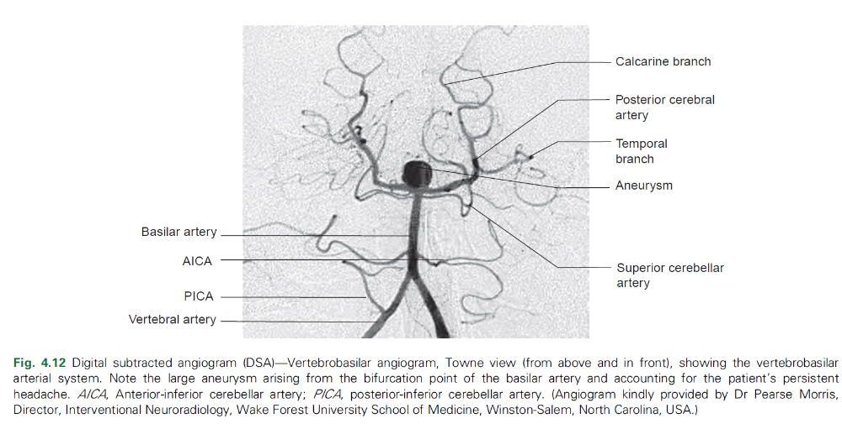
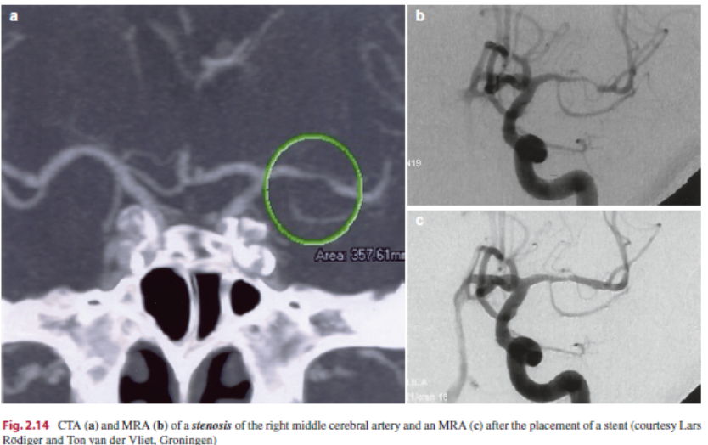
Stroke
Interruption of the blood flow to the brain or retina
Ischemic (85%)
  Atherosclerosis (fatty deposits in internal carotid or vertebral arteries)
  Atherothrombosis
  Lacunar
Haemorrhagic (15%)
  Intracerebral (10%) vs subarachnoid (5%)
  Aneurysm

Slide 45
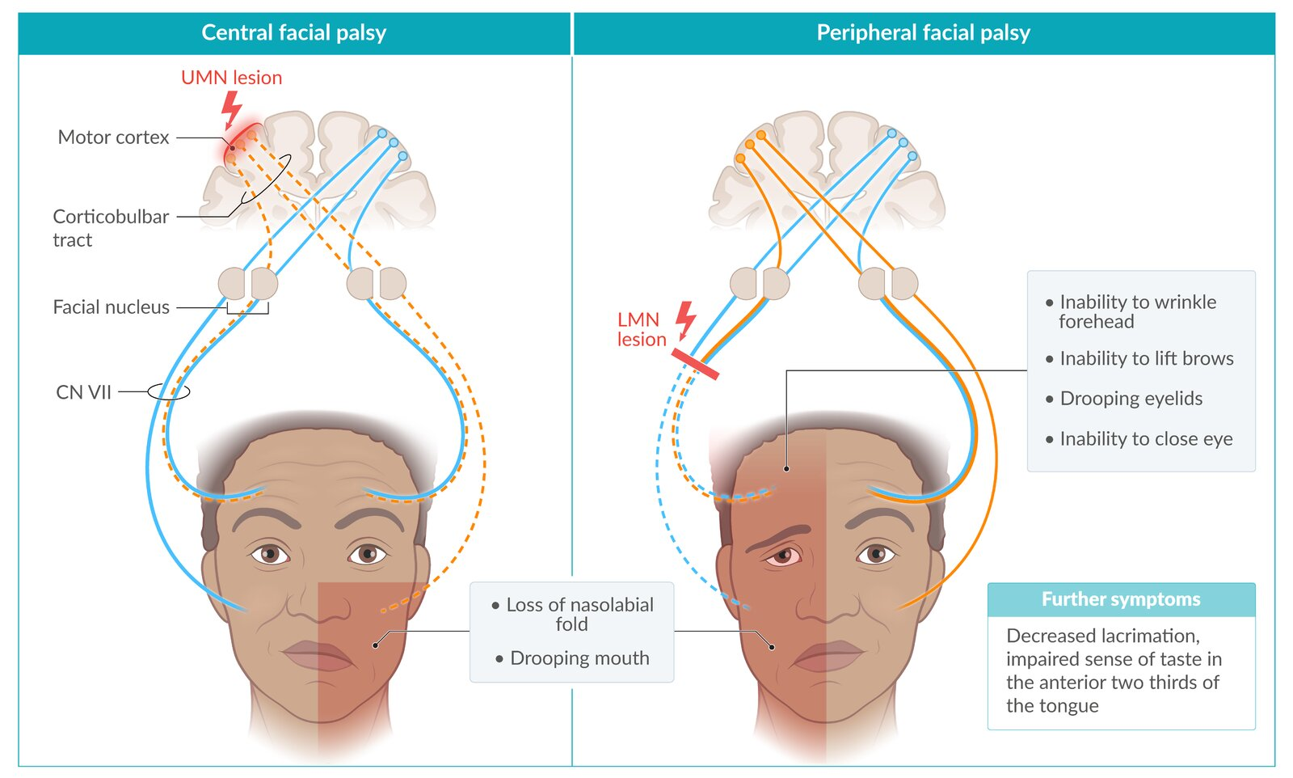
Upper vs Lower motor neuron lesions: Facial Nerve

Slide 46
Upper motor neuron syndrome: symptoms
Tendency to affect specific muscle groups
Weakness/fatigability/decreased muscle control
Positive symptoms ↓
Symptom | Definition
Spasticity | Velocity-dependent increase in a muscle’s resistance to a passive stretch
Clonus | Sequence of rhythmic, involuntary muscle contractions to stretch stimuli
Hyperreflexia | Abnormal deep tendon reflex to stretch stimuli (eg patellar tendon reflex)
Hyporeflexia | (Specific) Reduced or abolished superficial abdominal reflex and cremasteric reflex
Synkinesia | Voluntary movement of one muscle provokes the involuntary movement of another

Slide 47
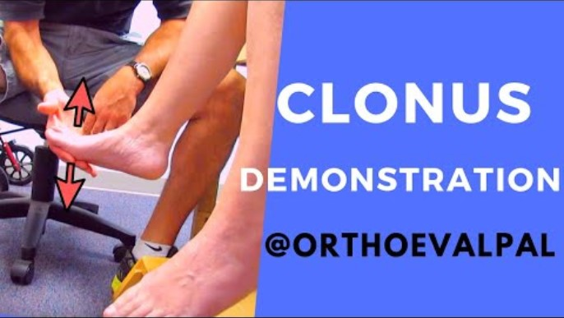
Clonus and hyperreflexia examples

Slide 48
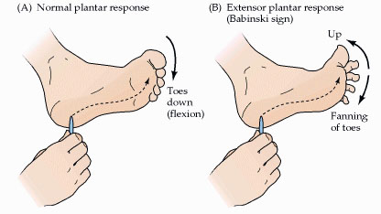
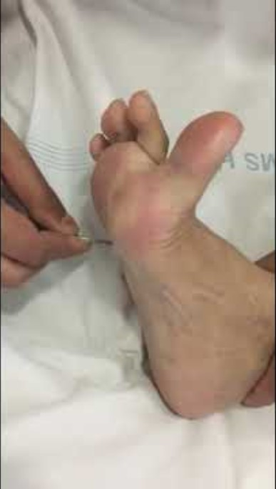
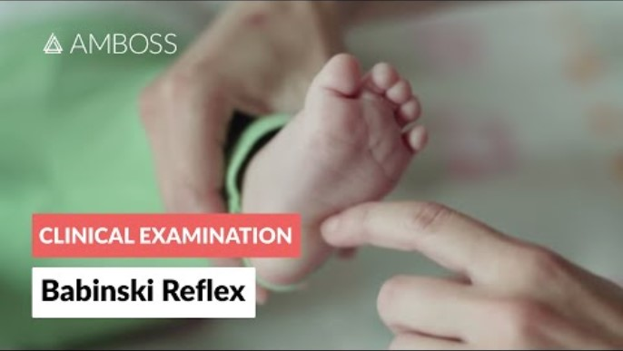
Babinski sign
Normal in infants!

Slide 49
Upper vs Lower motor neuron lesions
 | Upper Motor Neuron | Lower Motor Neuron
Site of Lesion | Cortex and descending tracts up to the spinal cord | Anterior horn neurons, spinal cord roots, nerves
Muscle weakness | Present | Present
Muscle tone | Spasticity, clonus | Hypotonia
Fasciculations | Absent | Present
Tendon Reflexes | Hyperreflexia | Hyporeflexia
Abdominal reflexes | Absent or reduced | Present

Slide 50
Case 1
Left face/arm/leg numbness and/or weakness
Left hemispatial neglect
Gaphaesthesia (inability to recognize symbols on the skin) and astereognosis (inability to recognize shape and size of objects by touch)
Gaze preference to the right
Right Middle Cerebral artery occlusion

Slide 51
Case 2
Contralateral motor weakness
Sensory loss
Urinary incontinence for some days
Abulia (lack of initiative)
Mutism
Ideomotor apraxia
Left Anterior
Cerebral artery branch occlusion - callosomarginal
Blood supply to the SMA and lower limb and perineal areas of sensorimotor cortex and supplementary sensory area

Slide 52
Case 3
Cortical blindness (Anton’s syndrome) with complete visual loss
Anosognosia (lack of awareness of the disease) about the deficit
Prosopagnosia (inability to recognise people or their faces)
Achromatopsia (inability to match colours with their names when presented)
Bilateral Posterior Cerebral
Artery occlusion

Slide 53
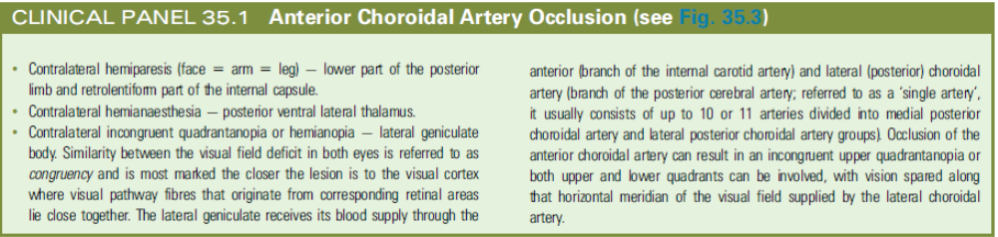
Further occlusions combinations

Slide 54
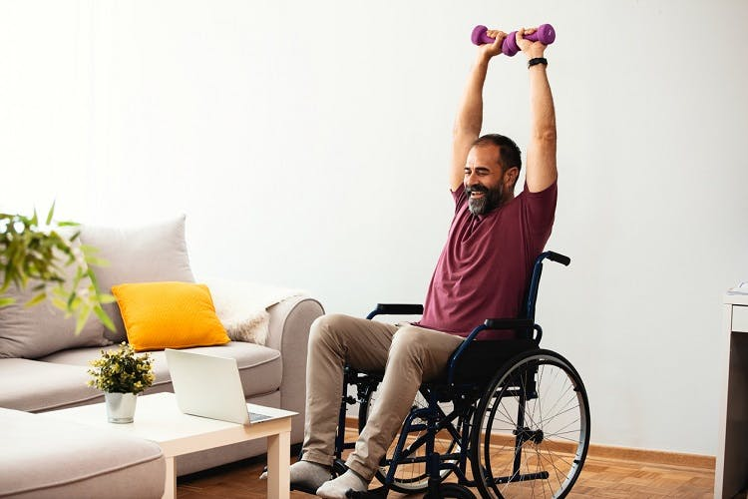
Intervention in Upper Motor neuron syndrome
“To reduce abnormal sensory inputs, in order to decrease excessive α−motor neuron activity”
Postural management
Exercise
Stretching and strengthening of limbs
  Casting
Splinting
Pain relief
Pharmacological and surgical interventions

Slide 55
Intervention in Upper Motor neuron syndrome
Physical therapy
  Tilt table/standing frame
  Progressive resistance exercise (PRE)
  Aerobic exercise
  Bobath therapy approach (direct assistance from the therapist)
  Mechanical gait trainer
  Passive movement/stretching of the joints
  Static positioning
  Reflex inhibitory thermoplastic splinting/orthotics

Slide 56
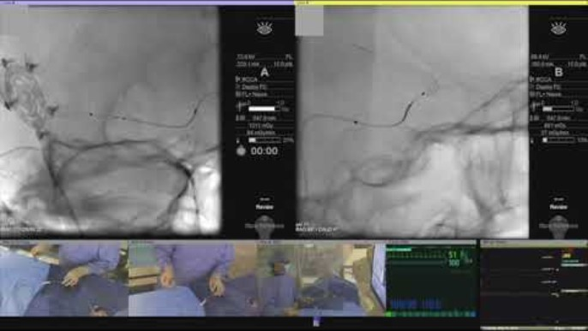
Stent intervention for aneurysm

Slide 57
Questions?
For follow-up questions:
vincenzo.mastrolia@kcl.ac.uk
Specific reading:
  Clinical Neuroanatomy, Hans J. ten Donkelaar, ISBN 978-3-642-19133-6
  Clinical Neuroanatomy and Neuroscience, Estomih Mtui & Gregory Gruener & Peter Dockery, ISBN 9780702079092

